Slide 1
Health Hub
To order/search for Health clubs, doctors, medical services, and hospitals
By
Sagar Shekhargouda Patil A20501427
Yuvraj Nikam A20501952
Suyog Bachhav A20466885

Slide 2
Project Description
The broad purpose of creating “HealthHub Application” is to offer health and wellness related services under one platform from expanded health service providers like doctors, hospitals, wellness centers and pharmacies.
This application will assist to search routine and ongoing patient care providers by providing access to local health care services that touches millions of lives every day.

Slide 3
Features and User Category
As a user/patient, I can
Register for HealthHub application.
Login in HealthHub application.
Searches for the health service providers based on available service providers.
Book/cancel appointments with the health service providers.
Write reviews on hospitals, doctors and wellness centers etc
View reviews on hospitals, doctors and wellness centers etc.
As a Medical Service Representative, I can:
Register for HealthHub application.
Login in HealthHub application.
Assist customers to searches for the health service providers.
Book/cancel appointments with the health service providers on behalf of customers.
Maintain the inventory of services rendered by Healthhub.

Slide 4
Features and User Category
As a HealthHub Manager, I can
Register for HealthHub application.
Login in HealthHub application.
Searches for the health service providers based on available service providers.
Book/cancel appointments with the health service providers on behalf of customers.
Maintain the inventory of services rendered by Healthhub.
Maintain the Medical Service representatives’ data.

Slide 5
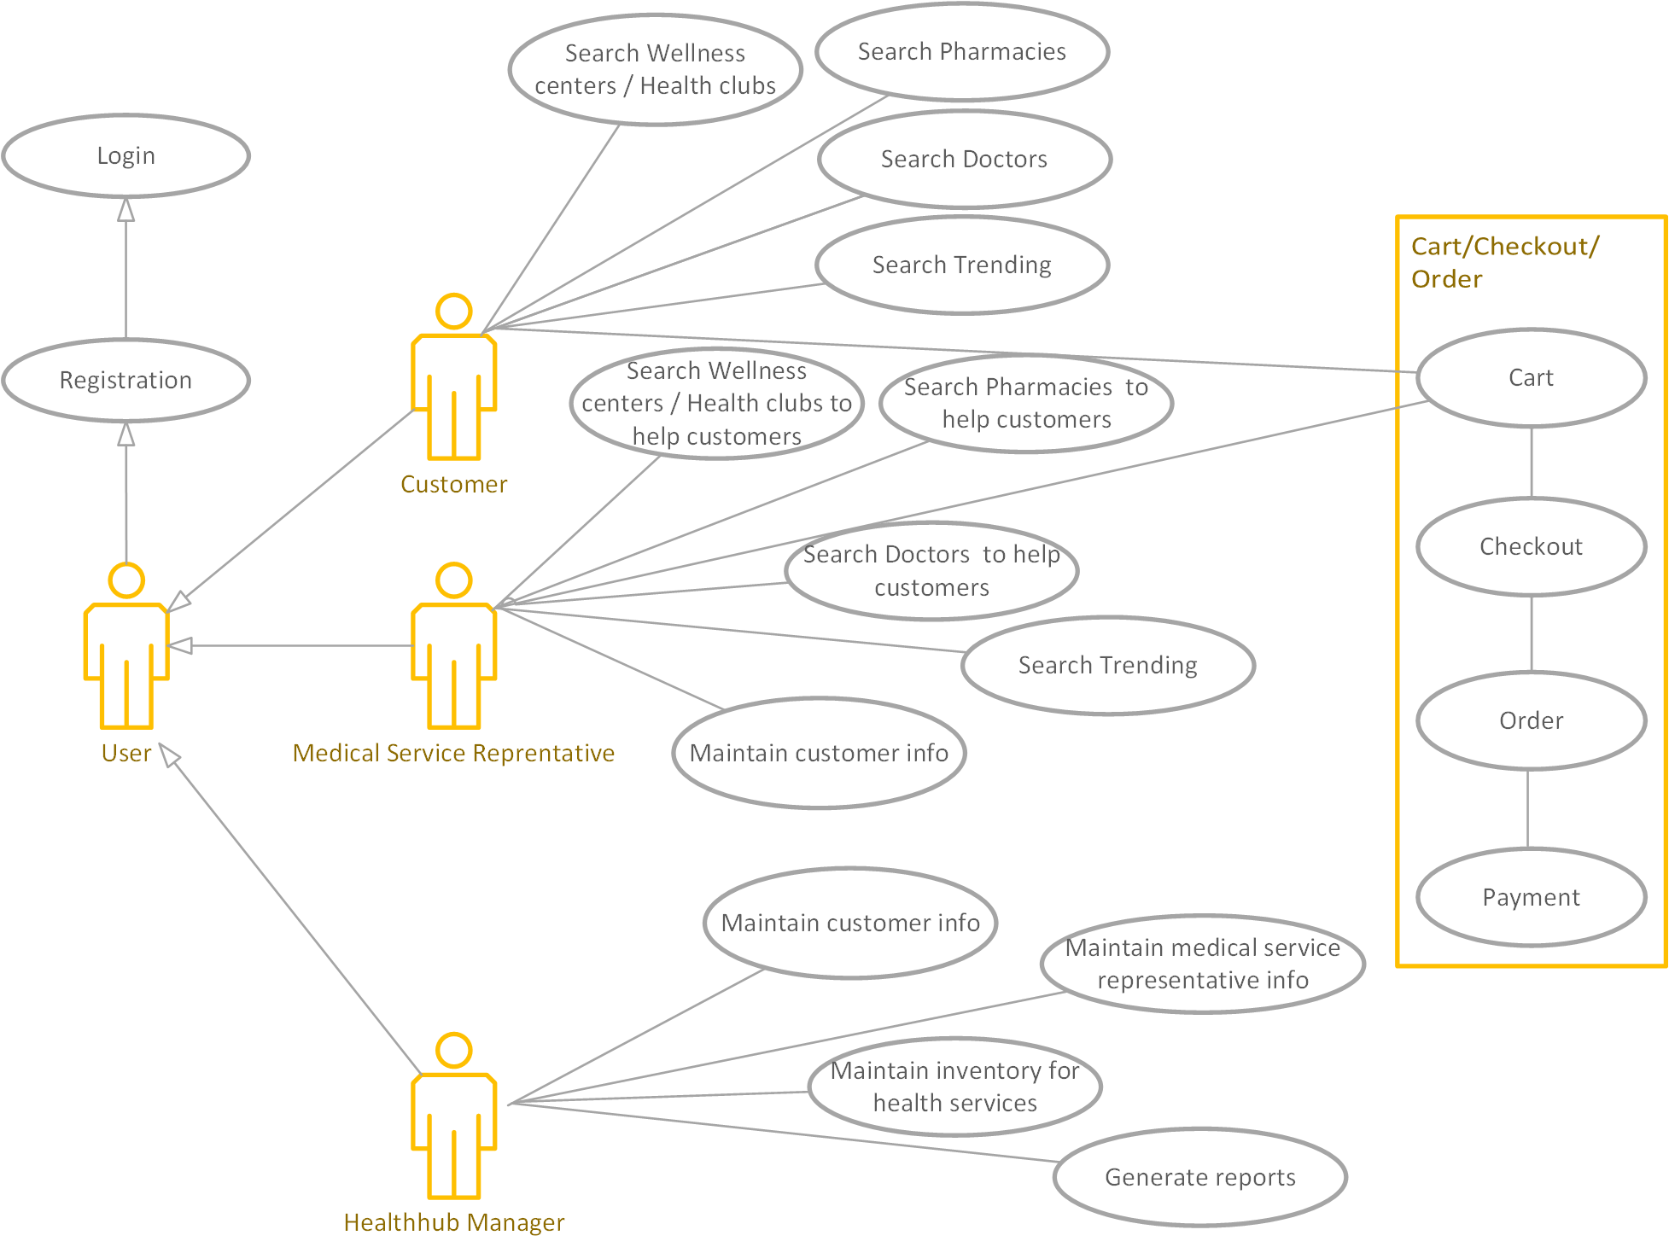
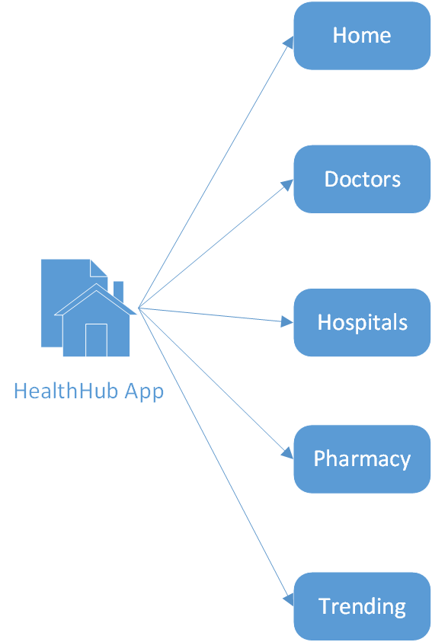
Information Architecture & Use Case Diagram

Slide 6
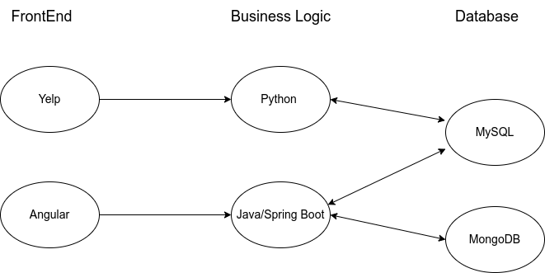
Project Architecture

Slide 7

Home Page

